Slide 1
Sprint 10
gwloggeR v0.2.0

Slide 2
Agenda
gwloggeR v0.2.0
?detect_drift()
Getting started page
Documentation
New Apriori() constructor
Other stuff
Next steps

Slide 3
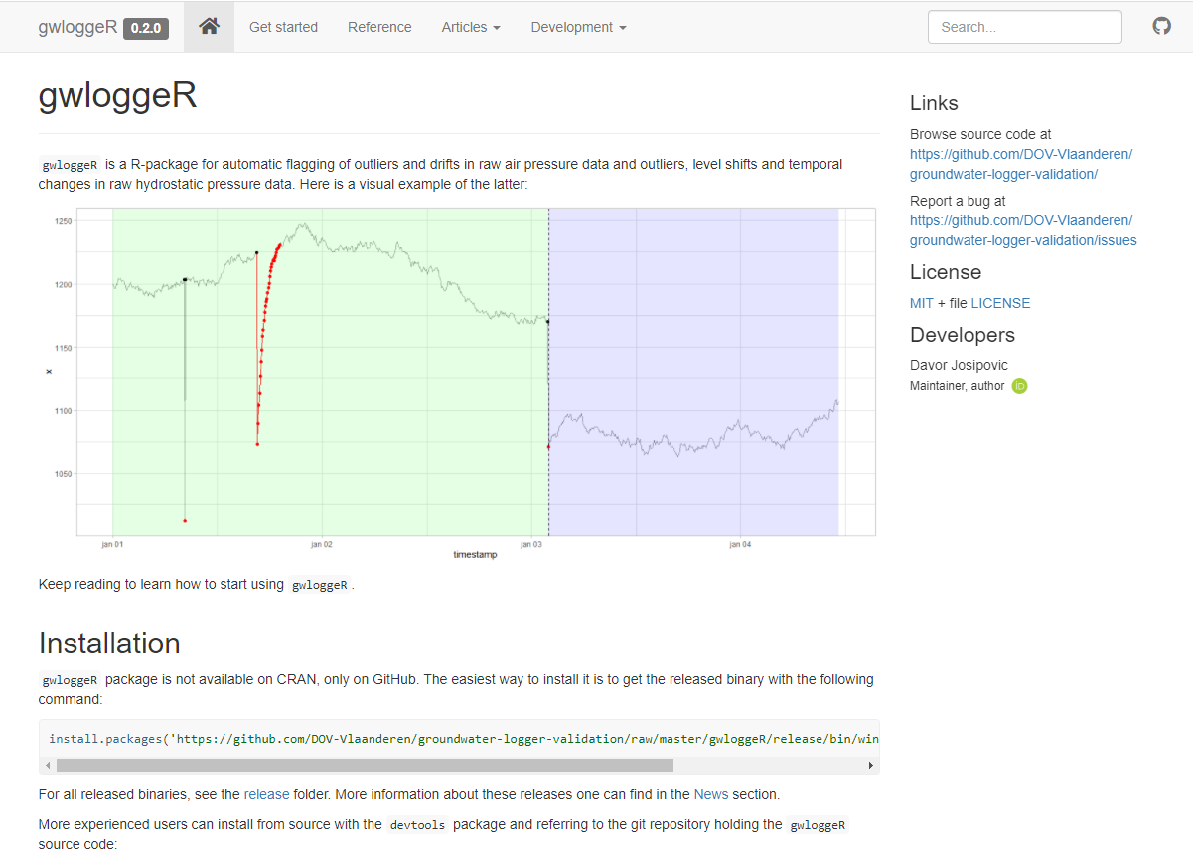
gwloggeR v0.2.0: installation

Slide 4
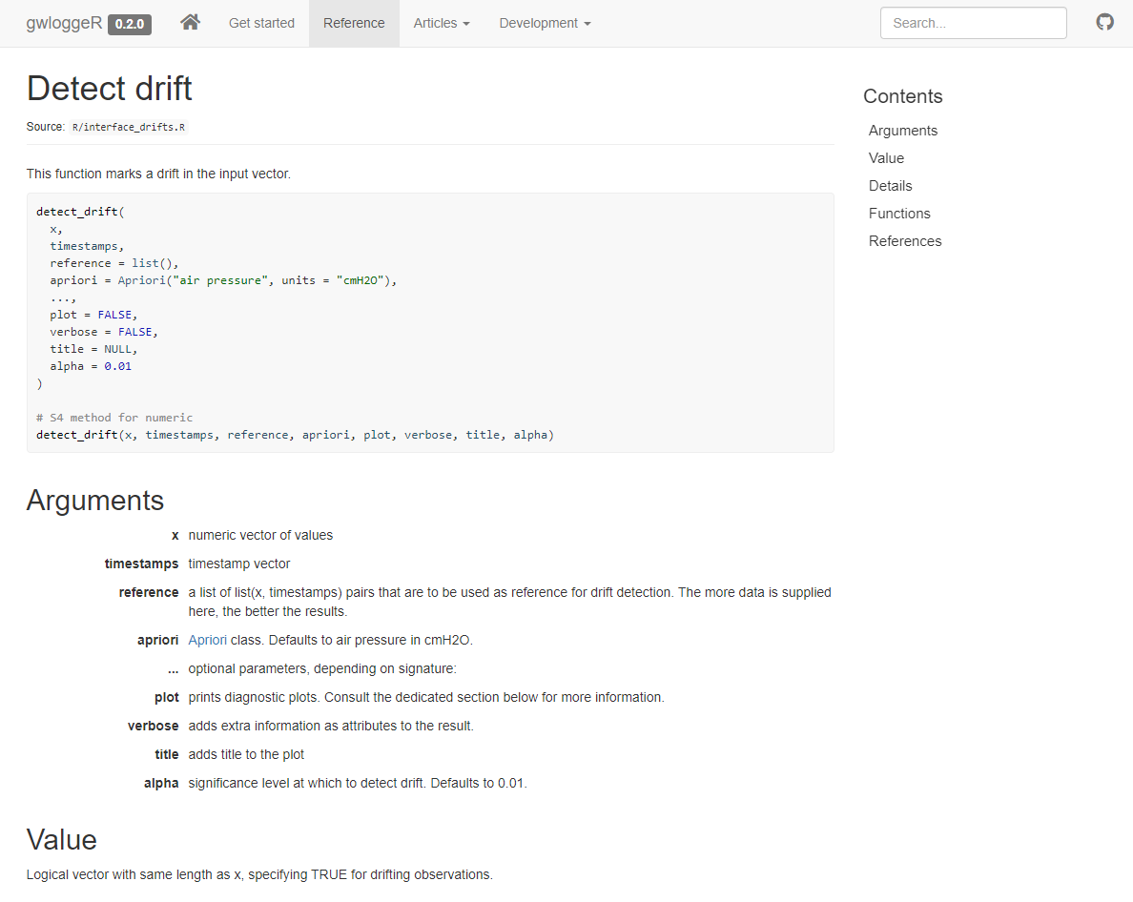
gwloggeR v0.2.0: ?gwloggeR::detect_drift

Slide 5
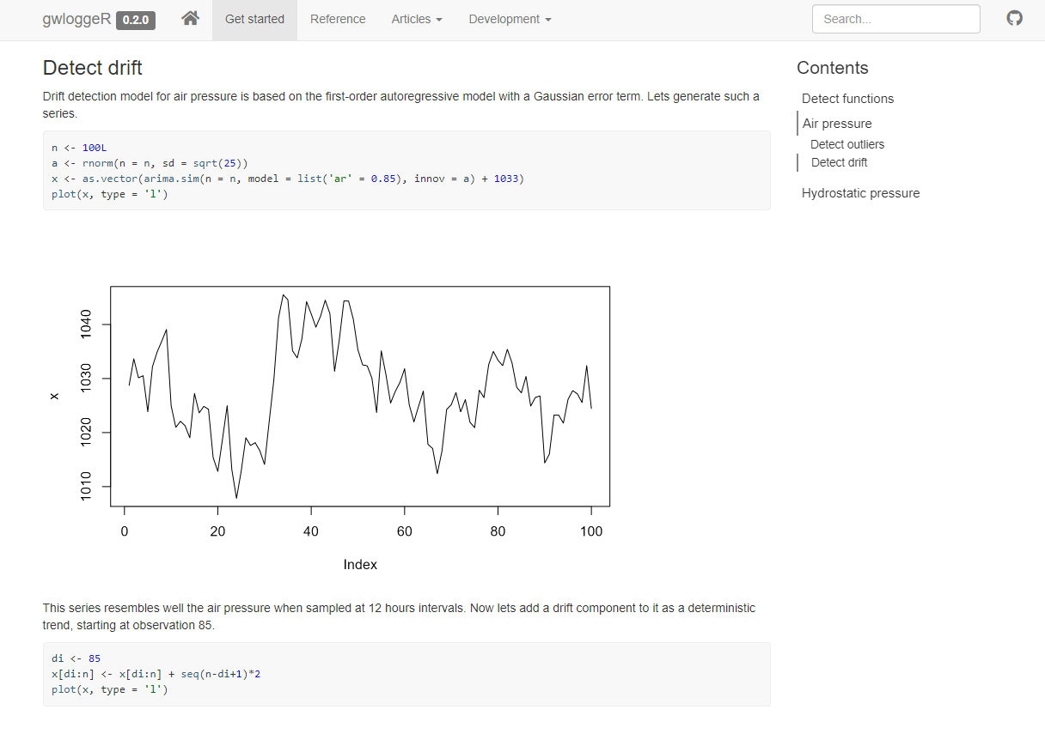
gwloggeR v0.2.0: getting started

Slide 6
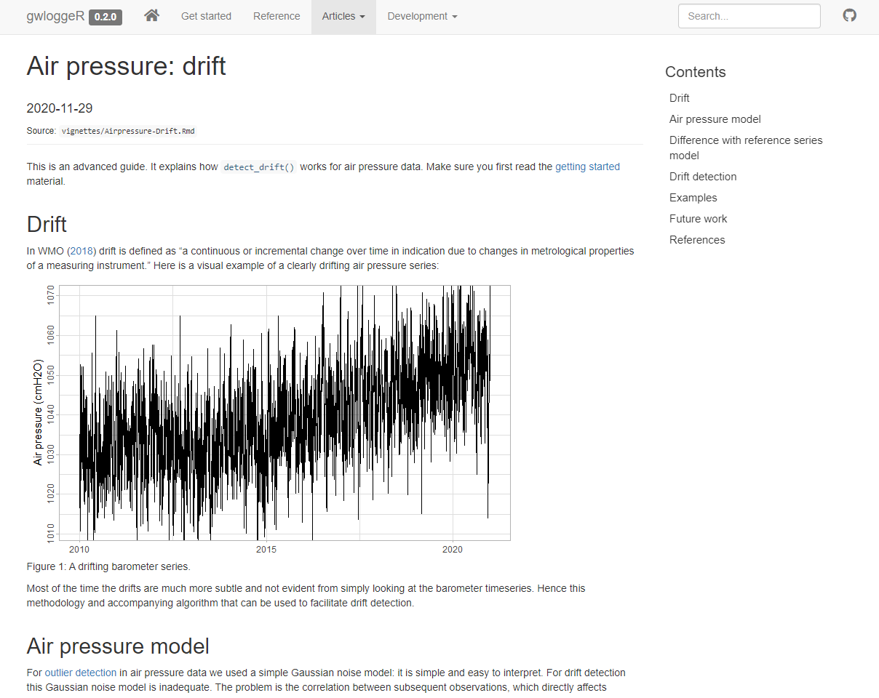
gwloggeR v0.2.0: documentation

Slide 7

gwloggeR v0.2.0: Apriori() constructor

Slide 8
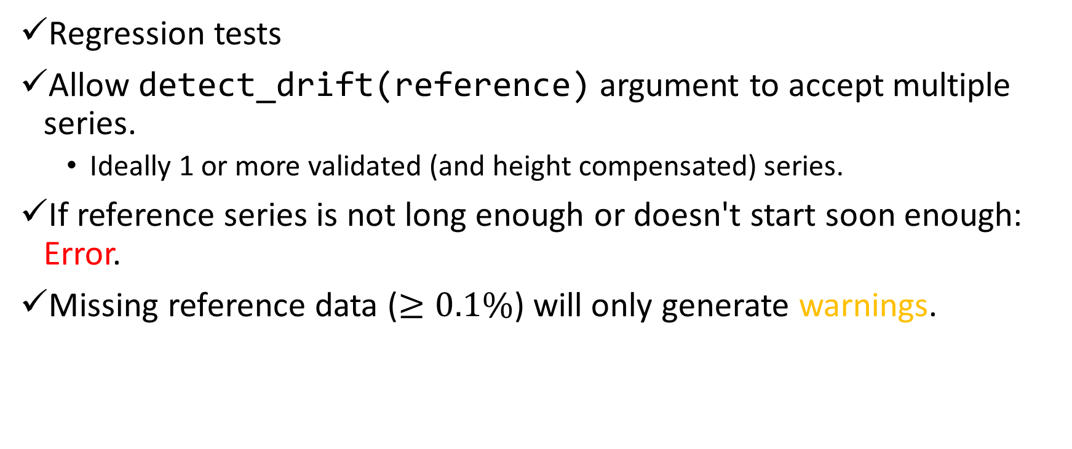
Other stuff
Regression tests
Allow detect_drift(reference) argument to accept multiple series.
Ideally 1 or more validated (and height compensated) series.
If reference series is not long enough or doesn't start soon enough: Error.
Missing reference data ($≥0.1\%$) will only generate warnings.

Slide 9
Next Steps
See future work:
Drift detection

Slide 10
The End

Slide 11
Sprint 9
drift detection: first version

Slide 12
Agenda
Seasonality analysis
Air pressure sampling intervals
Air pressure models
Linear
Best ARIMA
Fixed AR(1)
Importance of reference data
Drift significance calculation
detect_drifts()
v01 based on fixed AR(1) model
Next step proposals

Slide 13
Seasonality analysis

Slide 14
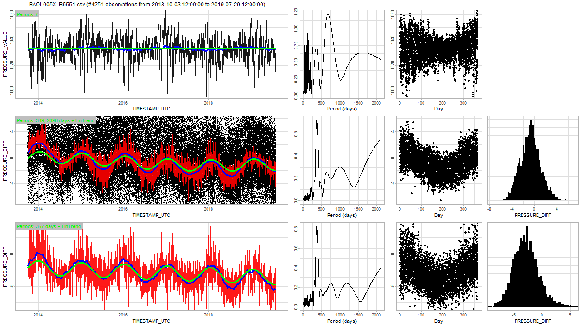
Seasonality analysis Full report

Slide 15
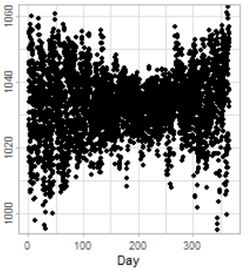
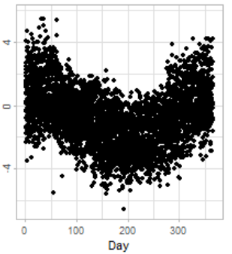
Seasonality analysis Full report
Key findings
All barometers exhibit higher air-pressure variance during non-summer (cf. all data)
Most probably a real effect
Some barometers exhibit seasonality effect when subtracted from the reference series
Cause?
Temperature effect?

Slide 16
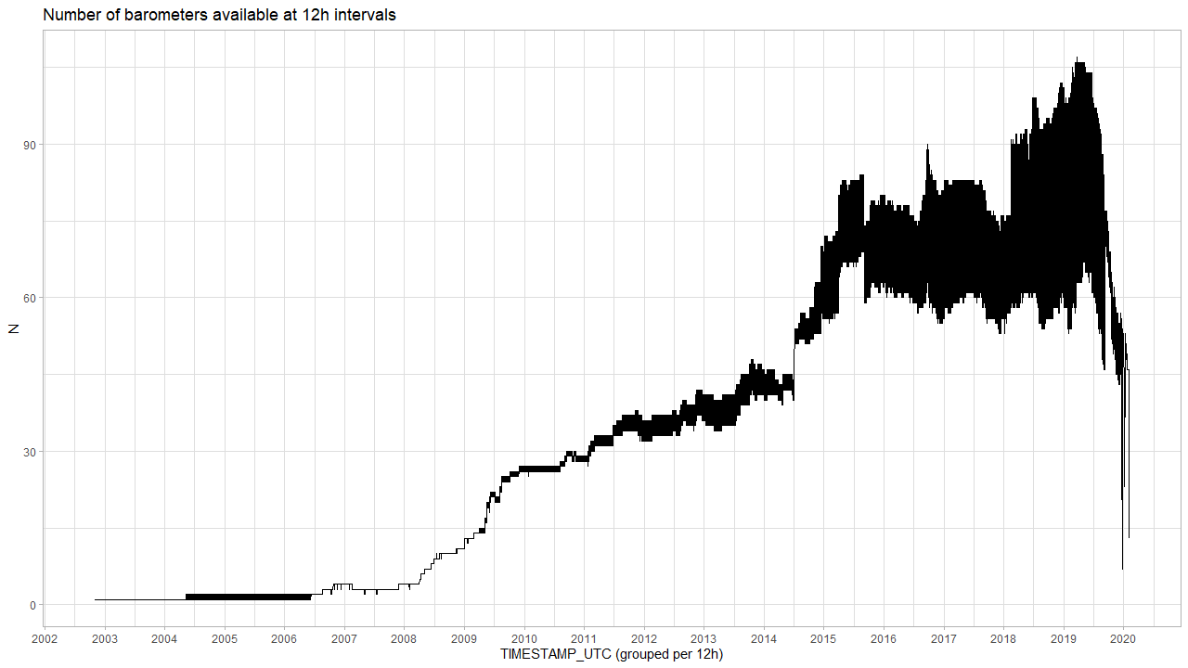
Air pressure sampling intervals Full report
The high variance in function of timestamp is because in this period there are lots of barometers that operate on 24h basis instead of 12h basis.

Slide 17
Air pressure models
Linear
Best ARIMA
Fixed AR(1)
Importance of reference data
Drift significance calculation

Slide 18
Air pressure models
All air pressure models for drift detection are based on differences with 1 or more reference series.

Slide 19
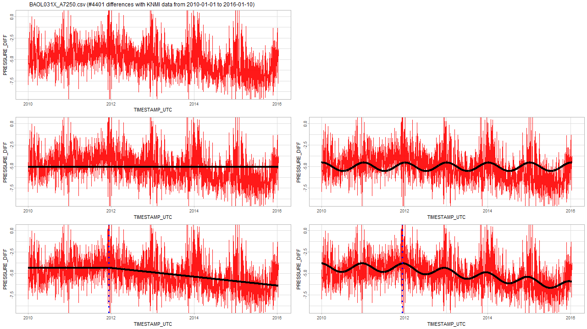
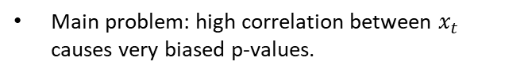
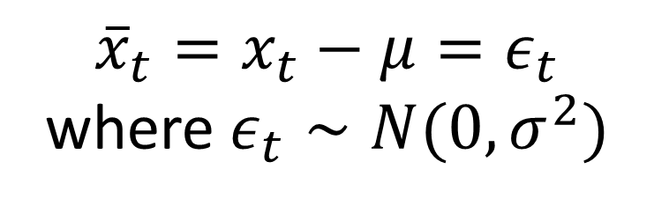
Air pressure models Simple linear model
${\overline{x}}_{t}=x_{t}−μ=ε_{t}$ where $ε_{t}∼N(0, σ^{2})$
Main problem: high correlation between $x_{t}$ causes very biased p-values.

Slide 20
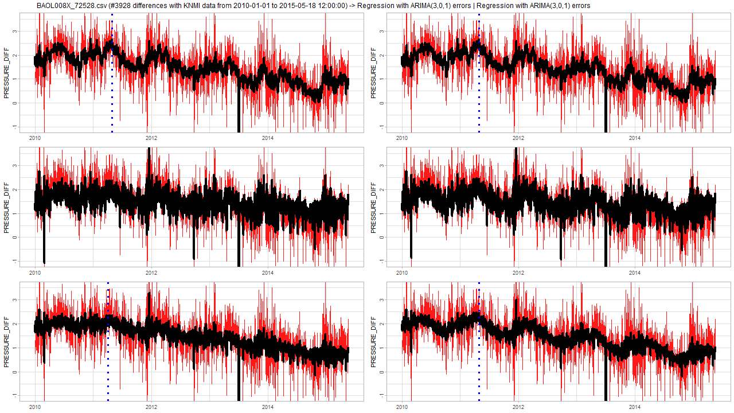
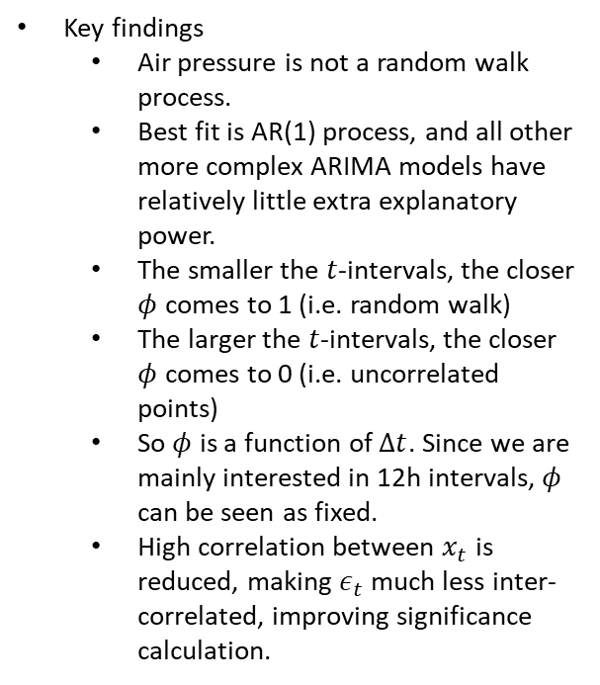
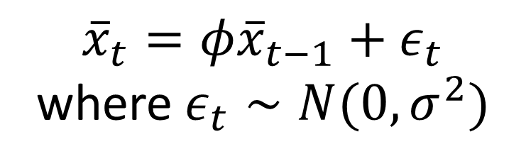
Air pressure models Best ARIMA model
${\overline{x}}_{t}=φ{\overline{x}}_{t−1}+ε_{t}$ where $ε_{t}∼N(0, σ^{2})$
Key findings
Air pressure is not a random walk process.
Best fit is AR(1) process, and all other more complex ARIMA models have relatively little extra explanatory power.
The smaller the $t$-intervals, the closer $φ$ comes to 1 (i.e. random walk)
The larger the $t$-intervals, the closer $φ$ comes to 0 (i.e. uncorrelated points)
So $φ$ is a function of $Δt$. Since we are mainly interested in 12h intervals, $φ$ can be seen as fixed.
High correlation between $x_{t}$ is reduced, making $ε_{t}$ much less inter-correlated, improving significance calculation.

Slide 21
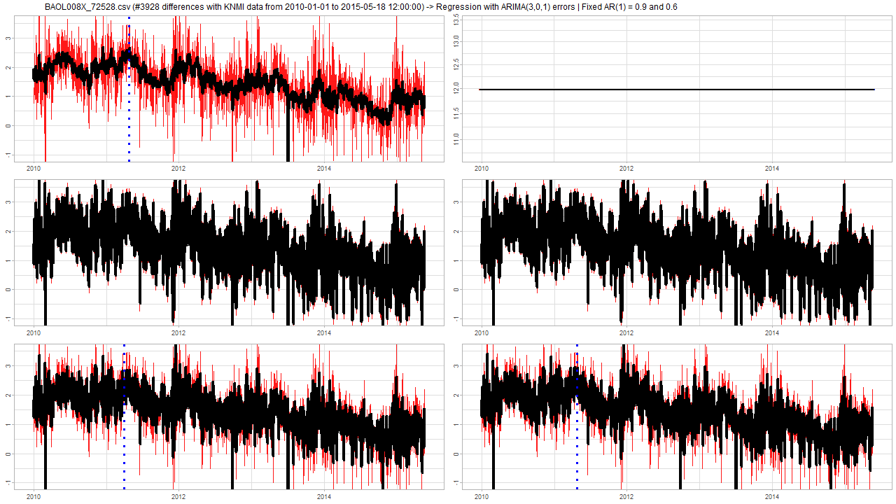
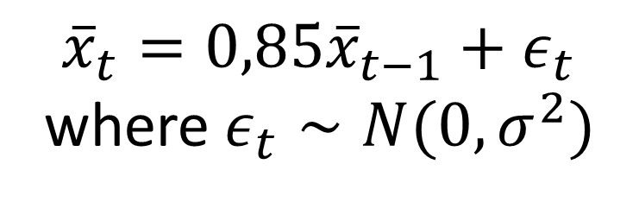
Air pressure models Fixed AR(1) = 0,9 model
A-priori
${\overline{x}}_{t}=0,85{\overline{x}}_{t−1}+ε_{t}$ where $ε_{t}∼N(0, σ^{2})$
Key findings
Based on analysis of all air pressure series, it seems that the optimal AR(1) component is somewhere between 0,85 and 0,9
Fixing AR(1) is like a-priori knowledge.
Reduces the risk of over/under-fitting in case of dirty data.

Slide 22
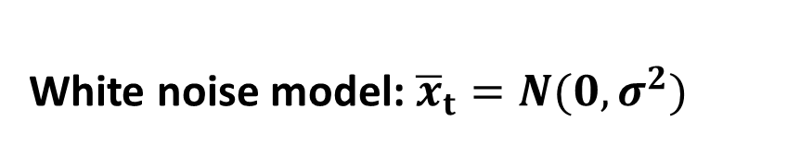
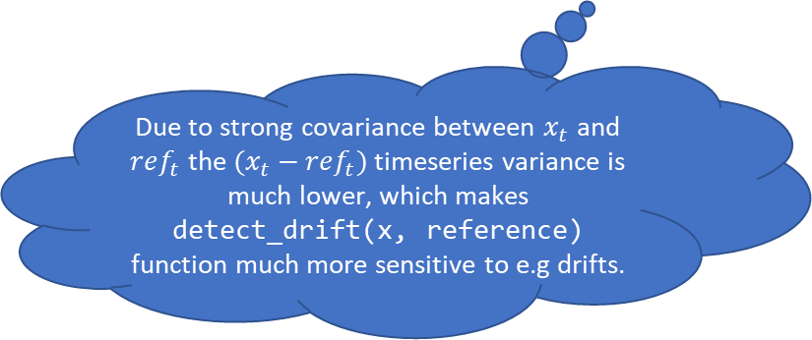
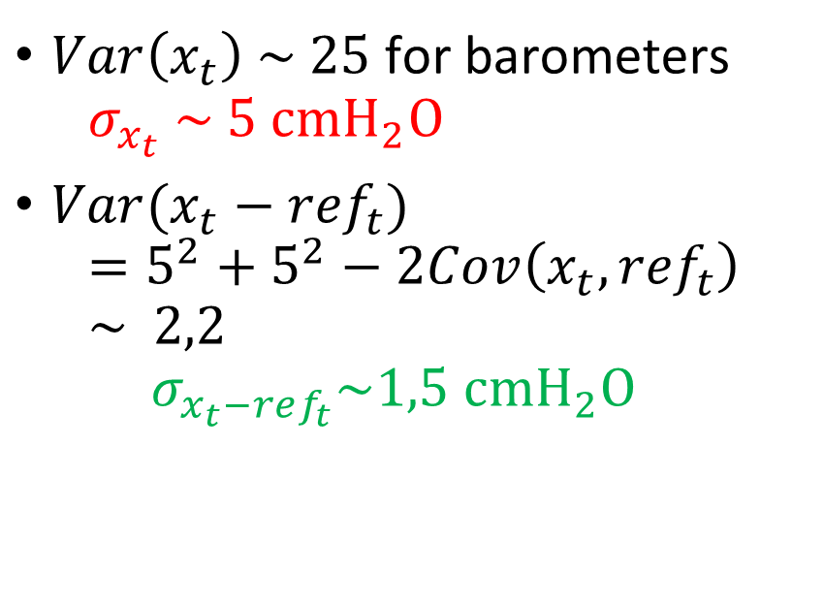
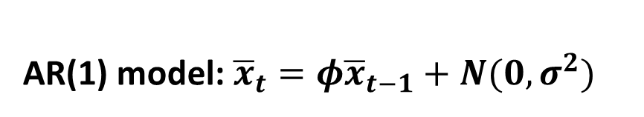
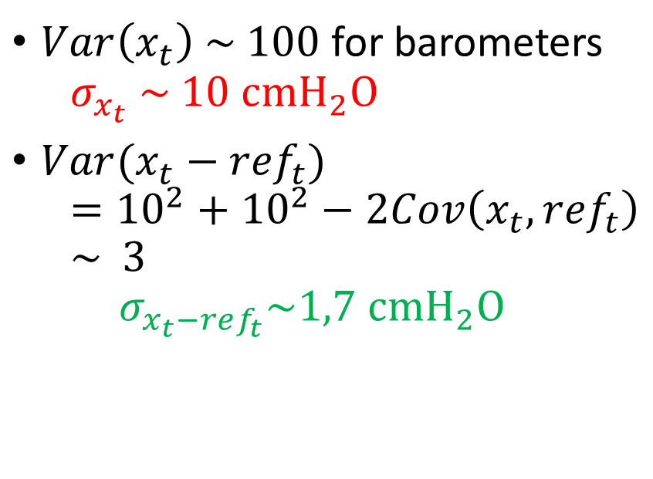
Importance of reference data (analysis 19) detect_drift(x) vs detect_drift(x, reference)
White noise model: ${\overline{x}}_{t}=N(0, σ^{2})$
AR(1) model: ${\overline{x}}_{t}={φ\overline{x}}_{t−1}+N(0,σ^{2})$
$Var\left(x_{t}\right) \sim 100$ for barometers $σ_{x_{t}} \sim 10 cmH_{2}O$
${Var(x}_{t}−{ref}_{t})$ $={10}^{2}+{10}^{2}−2Cov\left(x_{t},{ref}_{t}\right)$ $\sim 3$ $σ_{x_{t}−ref_{t}}\sim 1,7 cmH_{2}O$
$Var\left(x_{t}\right) \sim 25$ for barometers $σ_{x_{t}} \sim 5 cmH_{2}O$
${Var(x}_{t}−{ref}_{t})$ $=5^{2}+5^{2}−2Cov\left(x_{t},{ref}_{t}\right)$ $\sim 2,2$ $σ_{x_{t}−ref_{t}}\sim 1,5 cmH_{2}O$
Due to strong covariance between $x_{t}$ and $ref_{t}$ the $(x_{t}−ref_{t})$ timeseries variance is much lower, which makes detect_drift(x, reference) function much more sensitive to e.g drifts.
Notes:
White noise and AR(1) models are for raw barometer timeseries.
X_bar = X – mu
For white noise model: sigma2 goes from 106 for 65% best barometers down to 90 for Mathias selection
For AR(1) model: sigma2 goes from 21 for all data, up to 31 for Mathias selection – yes, larger here! (Don’t know why but seems this selection correlates less with previous values?)

Slide 23
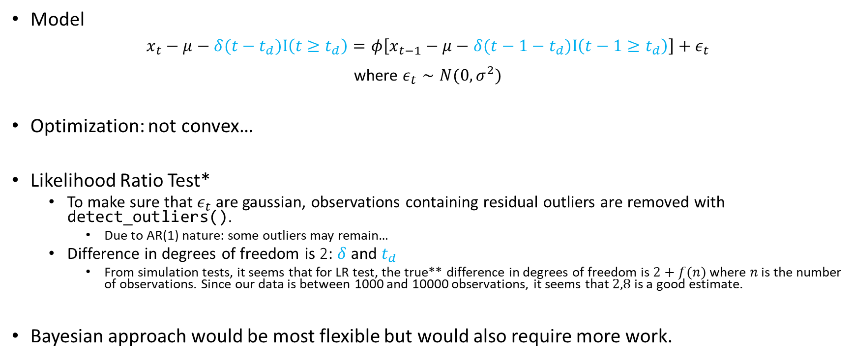
Drift significance calculation
Model
$x_{t}−μ−δ(t−t_{d})Ι\left(t≥t_{d}\right)=φ\left[x_{t−1}−μ−δ(t−1−t_{d})Ι\left(t−1≥t_{d}\right)\right]+ε_{t}$ where $ε_{t}∼N(0,σ^{2})$
Optimization: not convex…
Likelihood Ratio Test*
To make sure that $ε_{t}$ are gaussian, observations containing residual outliers are removed with detect_outliers().
Due to AR(1) nature: some outliers may remain…
Difference in degrees of freedom is 2: $δ$ and $t_{d}$
From simulation tests, it seems that for LR test, the true** difference in degrees of freedom is $2+f(n)$ where $n$ is the number of observations. Since our data is between 1000 and 10000 observations, it seems that $2,8$ is a good estimate.
Bayesian approach would be most flexible but would also require more work.
[*] Wilks, S.S., The Large-Sample Distribution of the Likelihood Ratio for Testing Composite Hypotheses, 1938

Slide 24
detect_drifts(x, ref = KNMI)
v01

Slide 25
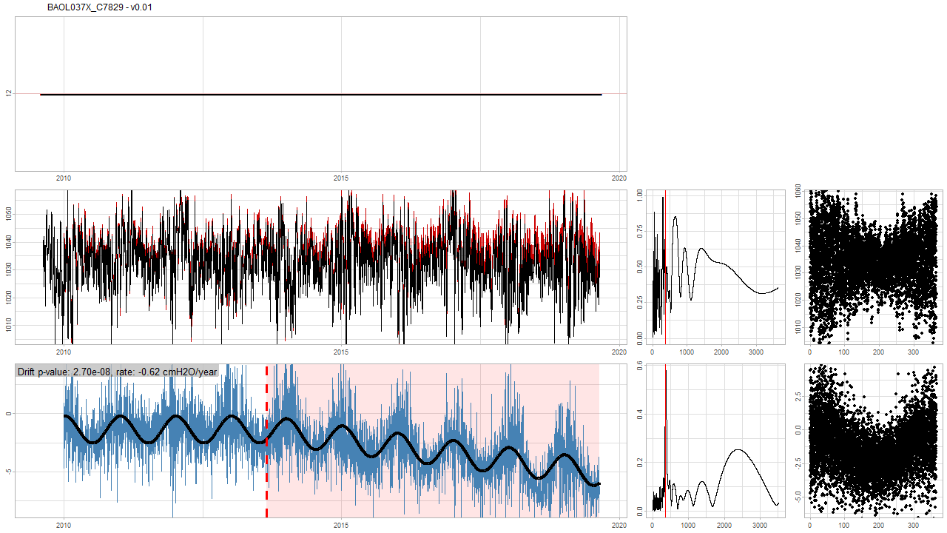
detect_drifts(x, ref = KNMI) v01 Full report

Slide 26
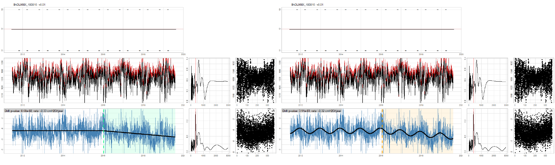
detect_drifts(x, ref = KNMI) v01 Full report: AR(1) = 0,90 (left) vs AR(1) = 0,85 (right)

Slide 27
Drift or seasonality?

Slide 28
Early detection

Slide 29
Unfortunate orange cases
Since orange starts at p-value < 1/100: 1 out of 100 on average will be wrong…

Slide 30
Next steps detect_drift()
What to do if reference series is not long enough or doesn't start soon enough.
Warning or Error?
At least 1 reference needed.
Multiple references:
Allow detect_drift(reference) argument to accept multiple series?
Reference data should be height-compensated: OK
Min 1 series needed for difference model: OK
Allow detect_drift() to fetch KMI/KNMI data?
Regression tests
Documentation
Some refactoring
Presentation for use (Jo etc.)

Slide 31
The End

Slide 32
Sprint 8
drifts analysis summary
gwloggeR update

Slide 33
Agenda
gwloggeR update
Test framework
Issue #47
Summary drift analysis
Multi comparison (one vs. all) vs Reference comparison (one vs KNMI)
Barometer overview: best to worst
Barometer altitude analysis
Next step proposals
detect_drifts() function

Slide 34
gwloggeR
Update

Slide 35
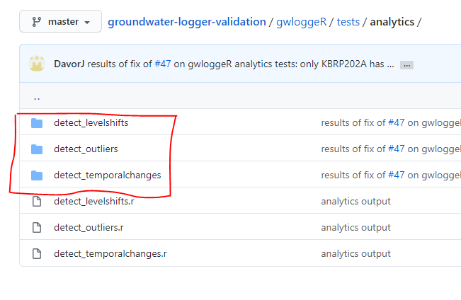
gwloggeR update Testing framework
For each function and each INBO/Geotech file:
Result
Image
Metadata
→ Testing framework makes sure that the package functions produce the same results as before, and only fix that what needs to be fixed.

Slide 36
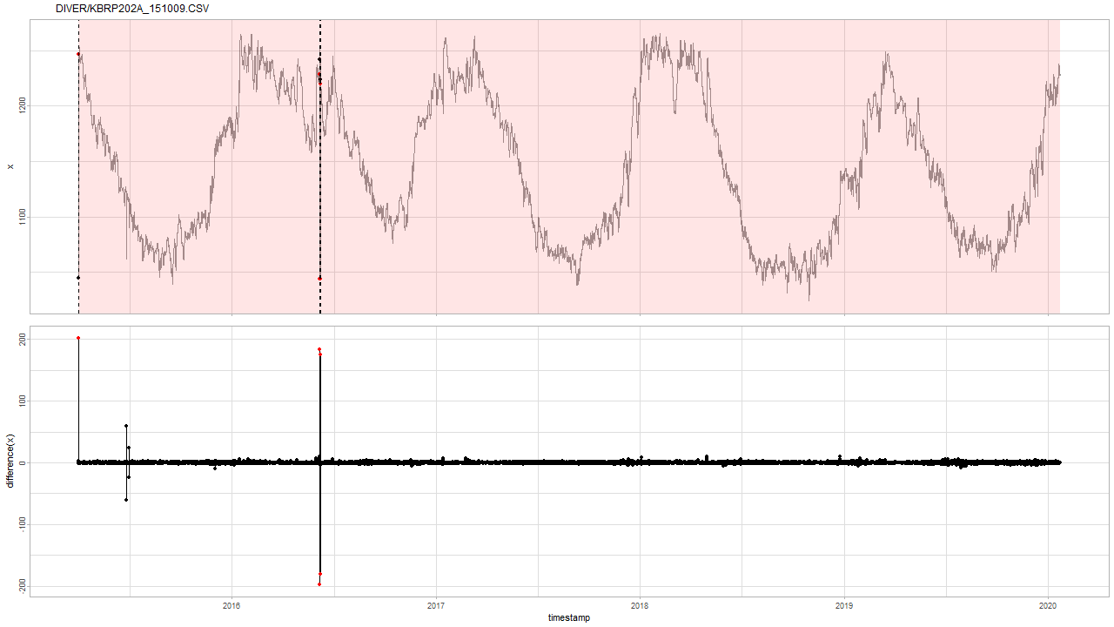
gwloggeR update Issue #47
Fix of issue #47 has only effect on this specific case.

Slide 37
Summary drift analysis
Multi- and reference comparison analysis
Barometer overview: best to worst

Slide 38
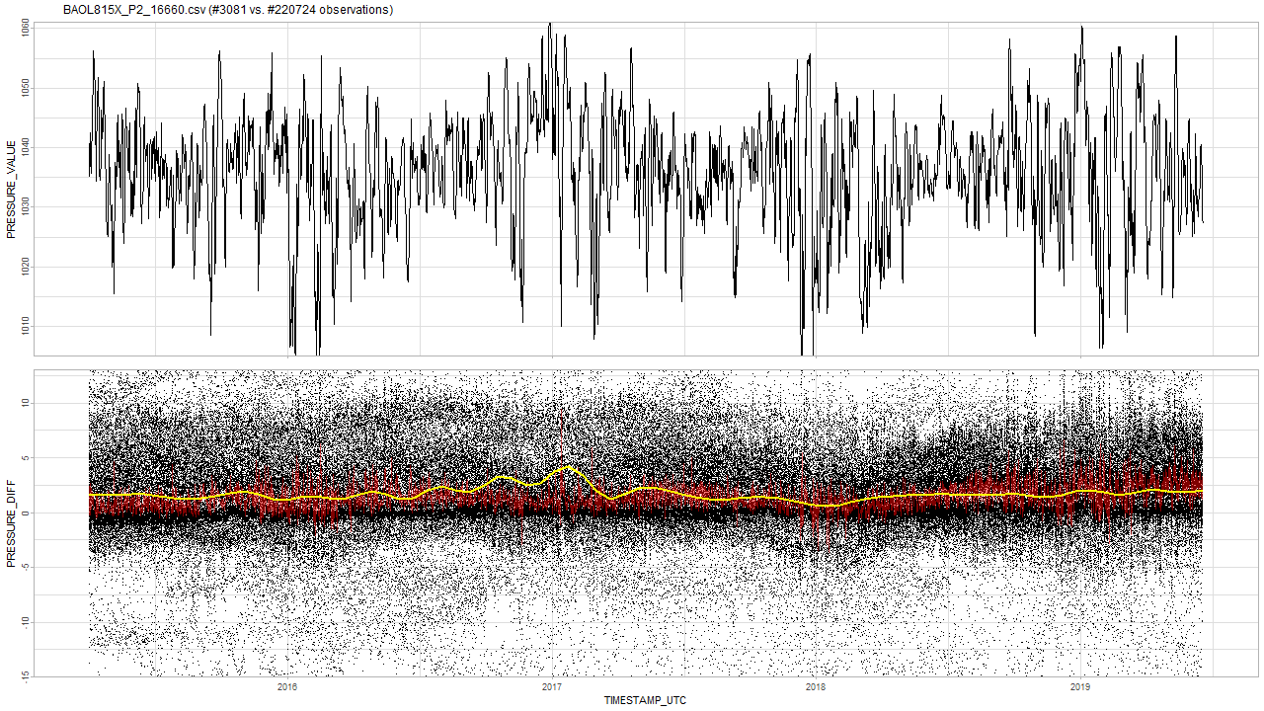
Multi comparison: good One barometer vs all the rest
Notes:
Zie voor theorie naar slides sprint 7.
Je verwacht een stationair rode lijn: vast gemiddelde met ruis errond.

Slide 39
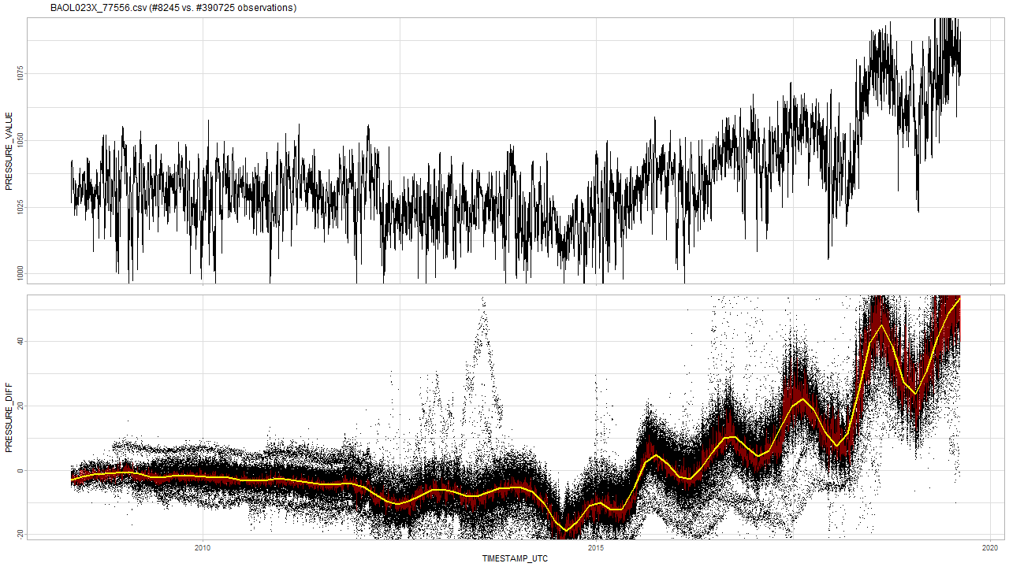
Multi comparison: bad One barometer vs all the rest
Notes:
De gemiddelde van de rode lijn is hier niet stationair, maar oscilleert en daalt zelfs.

Slide 40
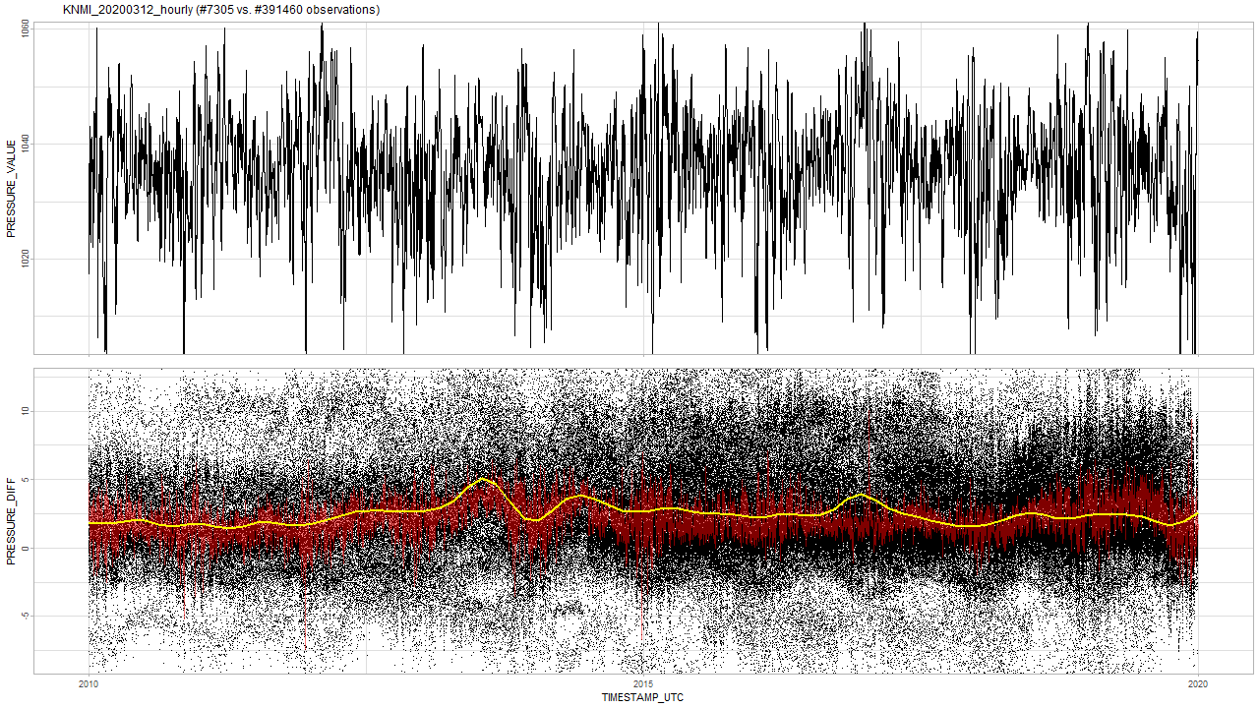
Multi comparison: KNMI (Westdorpe) KNMI barometer assessment based on multi comparison analysis
No drift and SD analysis suggests performance of an average INBO barometer.

Slide 41
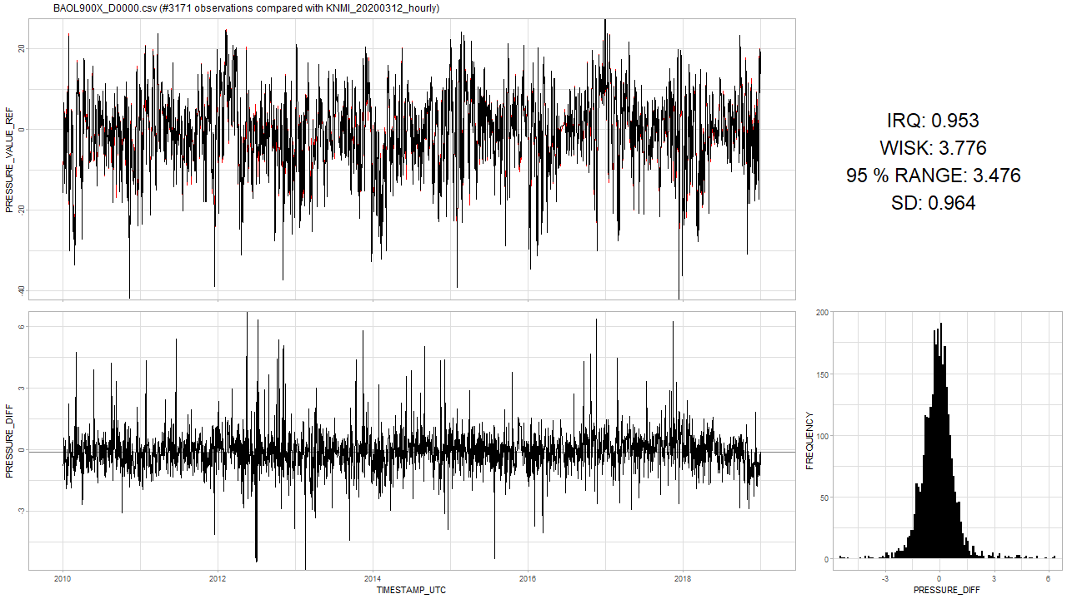
Reference comparison: good One barometer vs KNMI reference barometer

Slide 42
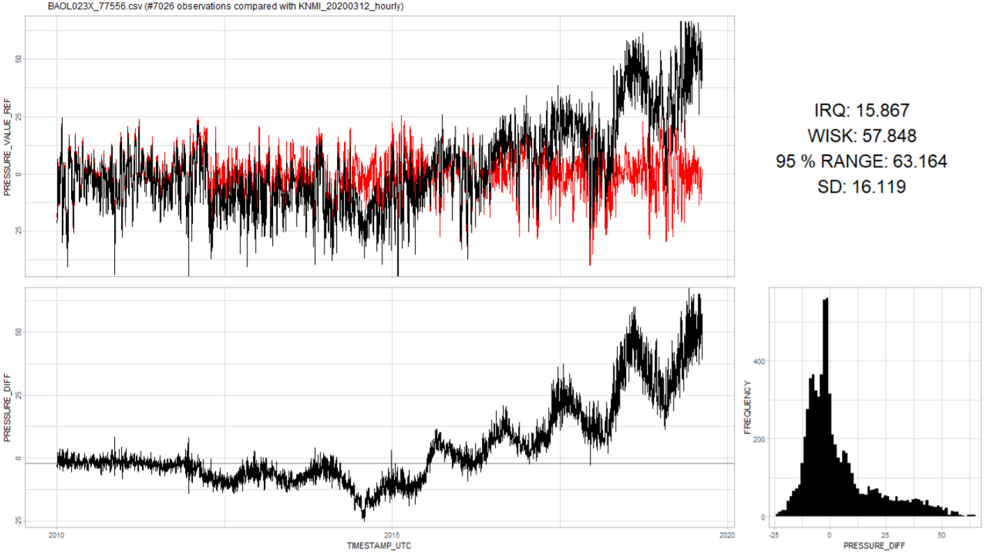
Reference comparison: bad One barometer vs KNMI reference barometer

Slide 43
Multi or reference comparison? Which analysis method is better?
Pretty much the same results
A possibly better question is: which one is more practical?
Need one good barometer.
Need lots of barometers.

Slide 44
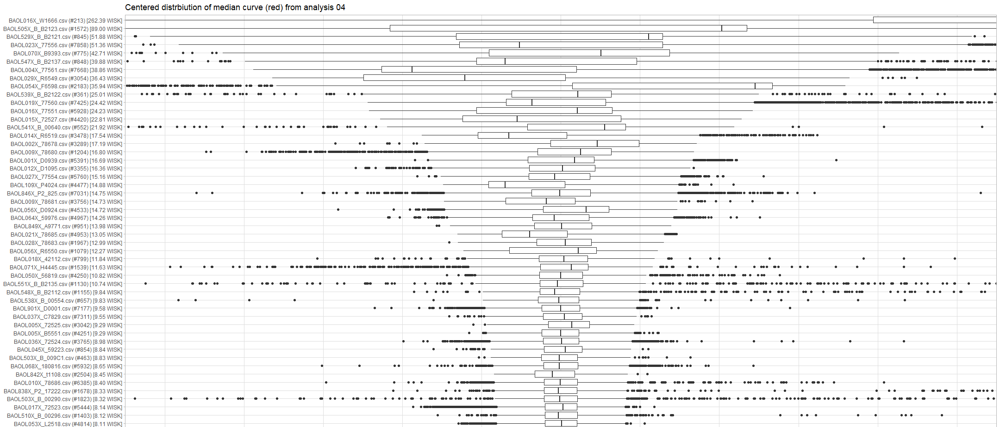
Overview Multi comparison overview based on IQR range

Slide 45
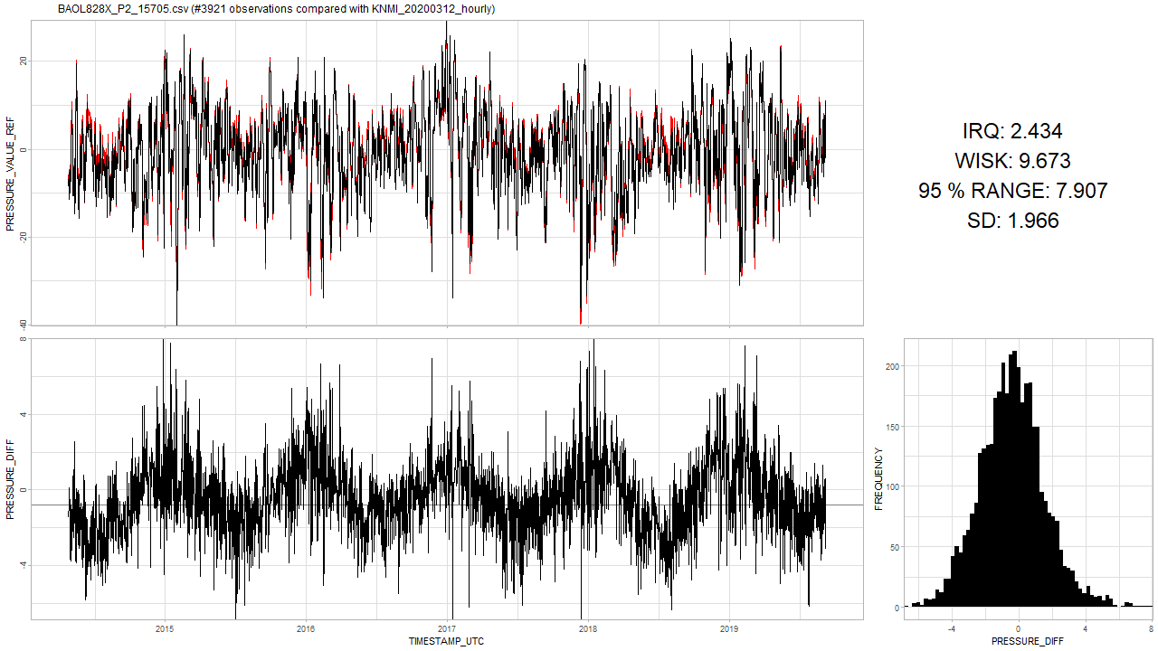
Seasonality in timeseries? Cf. WMO-No. 8: Guide to Instruments
“Most instruments measure temperature to compensate its effect.”
Electronic barometers (Ch 3.2, p119)
Capacitive sensors: diaphragm changing the capacitor → temperature dependent
Piezoresistive → can be made temperature independent and immune to hysteresis
Cylindrical resonator → temperature dependent
Aneroid (= “without fluid”) displacement: vs hydrostatic gauges → temperature dependent
“In order to maintain the acceptable performance of a barometer, the calibration corrections applied to the readings must be checked at relatively frequent intervals, for example, starting annually, for early detection and replacement of defective instruments.”

Slide 46
Barometer altitude analysis

Slide 47
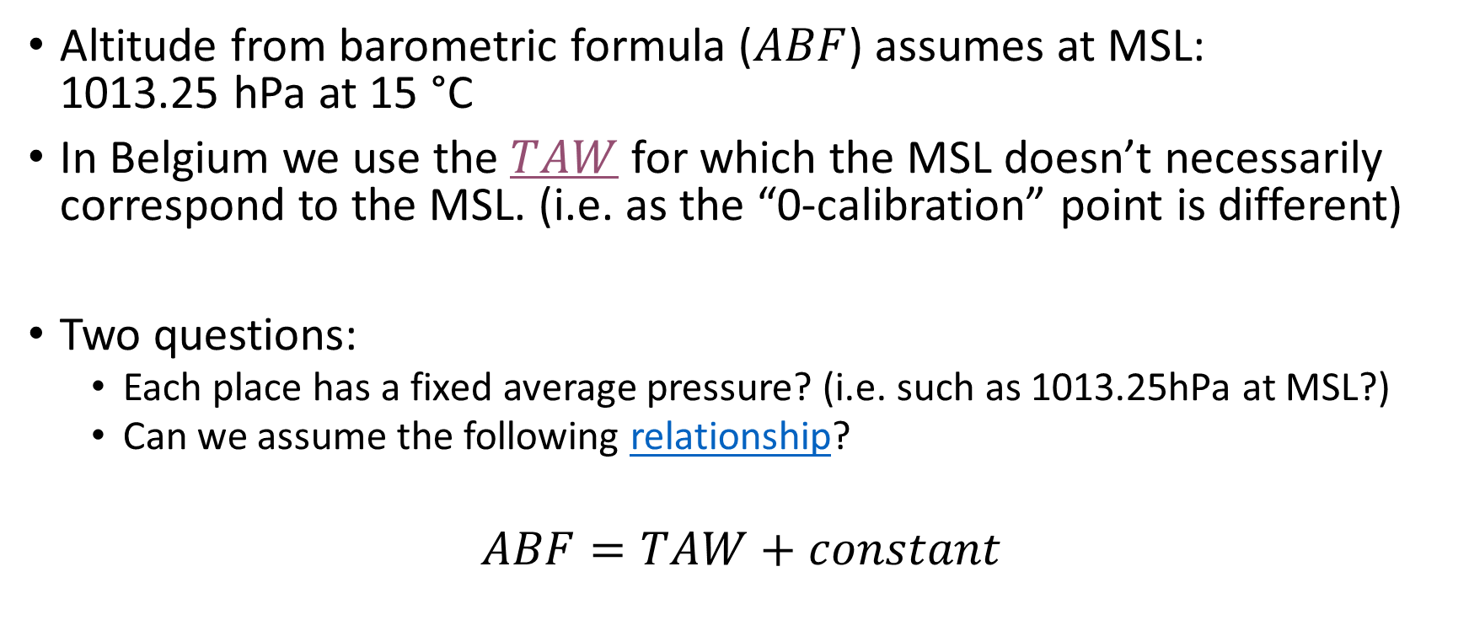
Barometer altitude analysis
Altitude from barometric formula ($ABF$) assumes at MSL: 1013.25 hPa at 15 °C
In Belgium we use the $TAW$ for which the MSL doesn’t necessarily correspond to the MSL. (i.e. as the “0-calibration” point is different)
Two questions:
Each place has a fixed average pressure? (i.e. such as 1013.25hPa at MSL?)
Can we assume the following relationship?
$$ABF=TAW+constant$$
Notes:
Note that in the barometric formula the assumption is that MSL is at 1013.25 hPa and 15 °C, In Belgium we use TAW as the MSL. So although we all use the same pressure reduction techniques, the "0-calibration point" is not necessarily the same.
ABF main purpose is to explain the differences in pressure in function of the altitude: where you place the “0-point” seems less important (although there is a slight impact since the 0-point temperature will have an impact on the laps rate.)

Slide 48
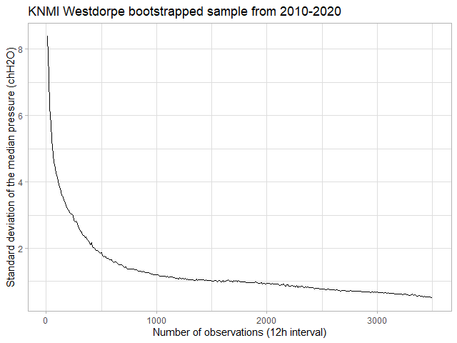
Barometer altitude analysis Fixed average pressure can be measured correctly?

Slide 49
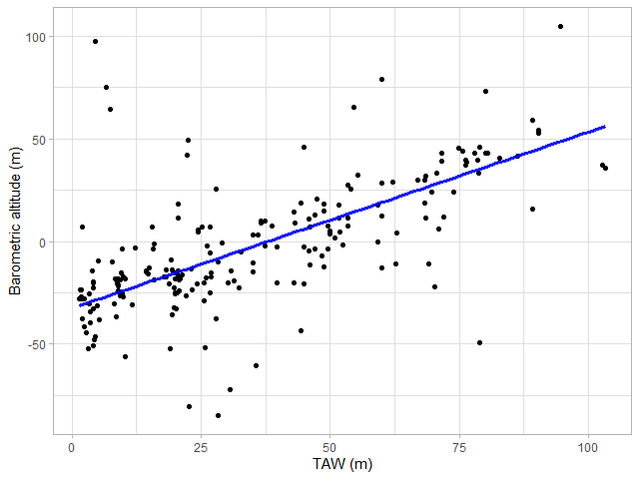
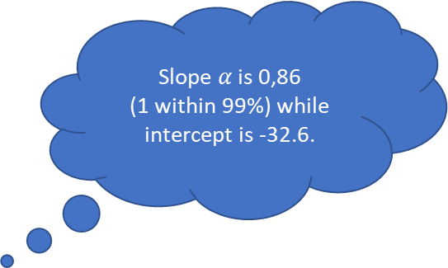
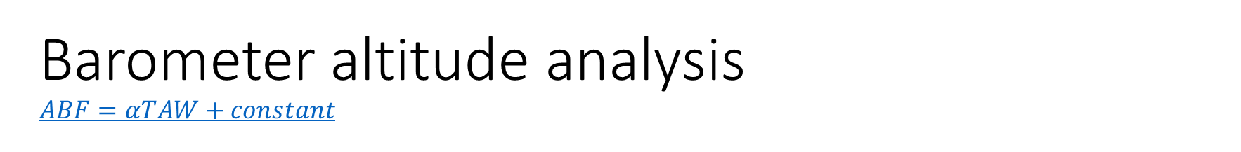
Barometer altitude analysis $$ABF=αTAW+constant$$
Slope $α$ is 0,86 (1 within 99%) while intercept is -32.6.

Slide 50
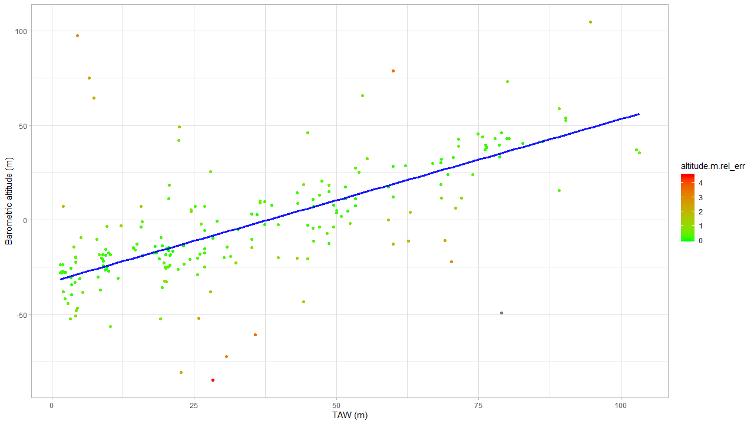

Barometer altitude analysis $$ABF=αTAW+constant$$
Not enough data: no evidence that broken.
Relative error: amount of data taken into consideration.
Barometer offset problem?

Slide 51
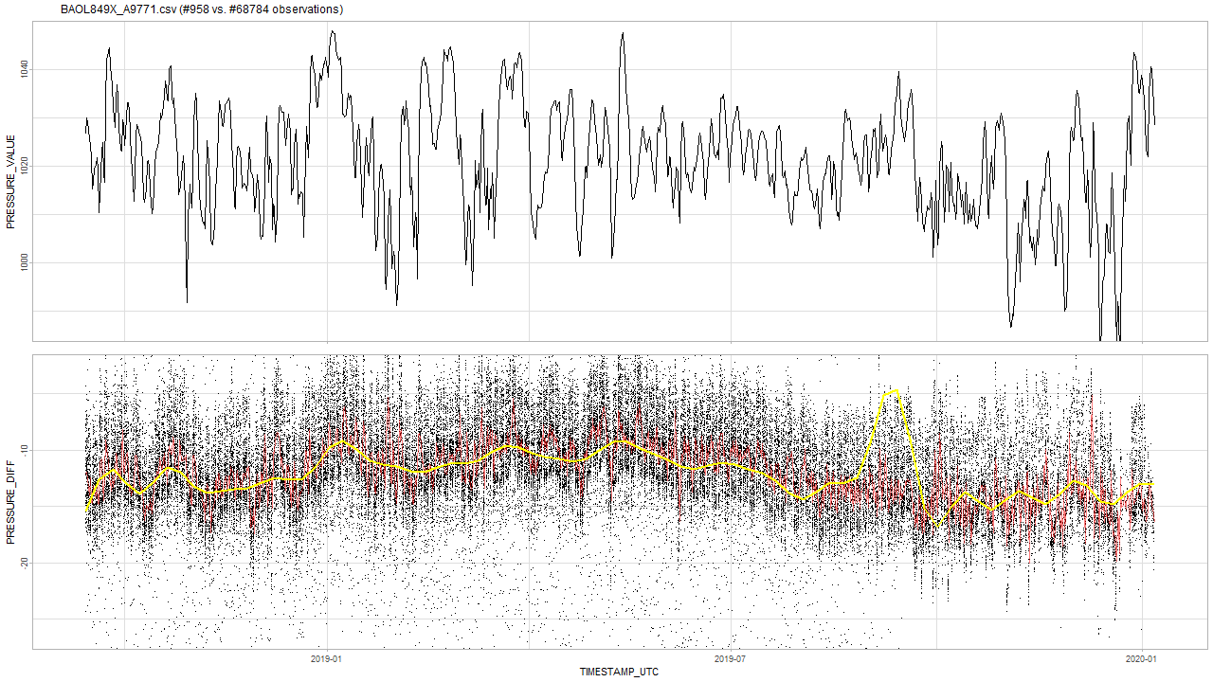
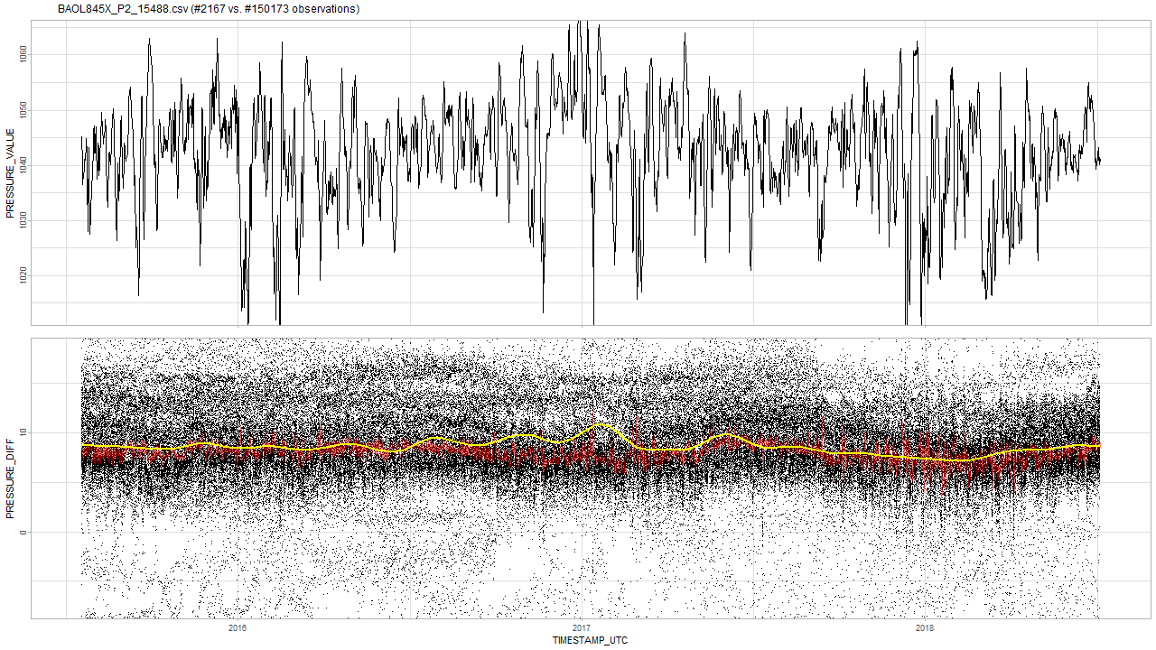
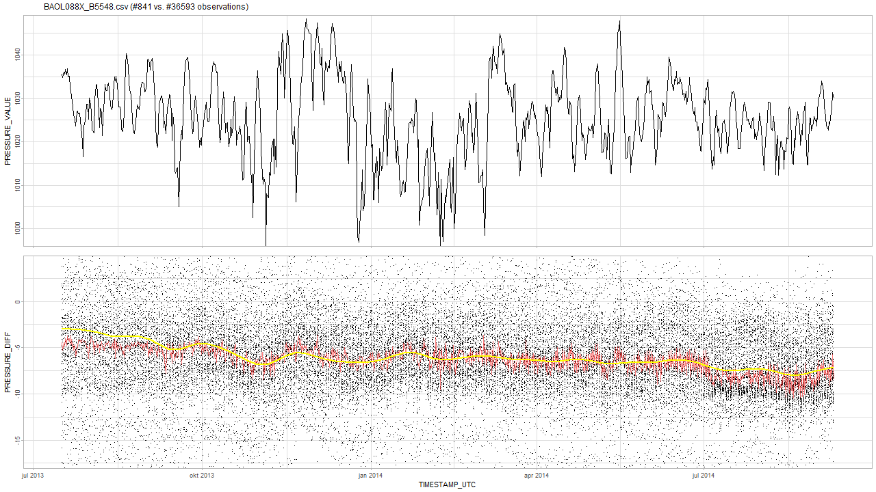
Barometer altitude analysis $$ABF=αTAW+constant$$
logger N altitude.m.bf RASTERVALU altitude.m.rel_err
1: barodata/BAOL015X_72527.csv 4420 -84.582470 28.29 4.495663
2: barodata/BAOL109X_P4024.csv 4477 78.818297 60.00 3.525451
3: barodata/BAOL004X_77561.csv 7667 -60.749429 35.72 3.467790
4: barodata/BAOL849X_A9771.csv 958 97.650572 4.45 3.068416 ***
5: barodata/BAOL029X_R6549.csv 3054 -72.348491 30.65 3.038848
6: barodata/BAOL019X_77560.csv 7425 -22.046760 70.25 2.936357
7: barodata/BAOL014X_R6519.csv 3478 -51.858903 25.82 2.395642
8: barodata/BAOL845X_P2_15488.csv 2167 -80.559779 22.67 2.279869 ***
9: barodata/BAOL027X_77554.csv 6065 -10.962409 69.11 2.225562
10: barodata/BAOL070X_B9393.csv 775 75.014820 6.59 2.220084 ***
11: barodata/BAOL088X_B5548.csv 841 64.536759 7.39 2.068103 ***
12: barodata/BAOL012X_D1095.csv 3355 7.058513 1.96 1.973851
13: barodata/BAOL093X_78679.csv 4396 -11.125500 62.70 1.910527 ***
14: barodata/BAOL064X_59976.csv 4967 -12.756265 59.96 1.867836
15: barodata/BAOL054X_F6598.csv 2165 104.657061 94.64 1.847558
16: barodata/BAOL071X_H4445.csv 1539 49.146993 22.42 1.794395 ***
17: barodata/BAOL009X_78681.csv 4023 -37.837886 27.89 1.721346
18: barodata/BAOL001X_D0939.csv 5391 7.197382 15.63 1.552928
Notes:
So although these barometers do not drift, their median pressures seem to be way off from what we expect, so I would advise to double-check them.

Slide 52
Next steps
detect_drift()

Slide 53
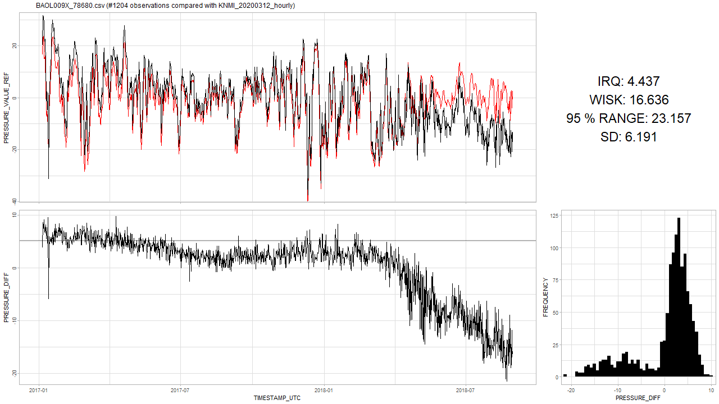
Next steps detect_drift()
Based on “Multi or Reference comparison” analysis.
Output should divide the timeseries in FALSE and TRUE (= drift)

Slide 54
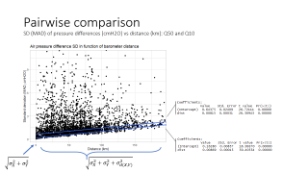

Next steps detect_drift()
Interface
detect_drift(x)
Probably the least precise: only information supplied is the time series of a barometer.
detect_drift(x, reference)
Based on reference comparison analysis:
Reference should be a good non-drifting barometer.
Reference should span the whole time-frame of x.
The larger the distance, the less accurate the results. (cf. “each 100km the error is 2 cmH2O due to distance”)
detect_drift(x, other, [altitude])
Based on multi comparison analysis:
Need most of the other barometers to make a comparison and thus detect drift.
Probably the most precise (not yet confirmed).

Slide 55
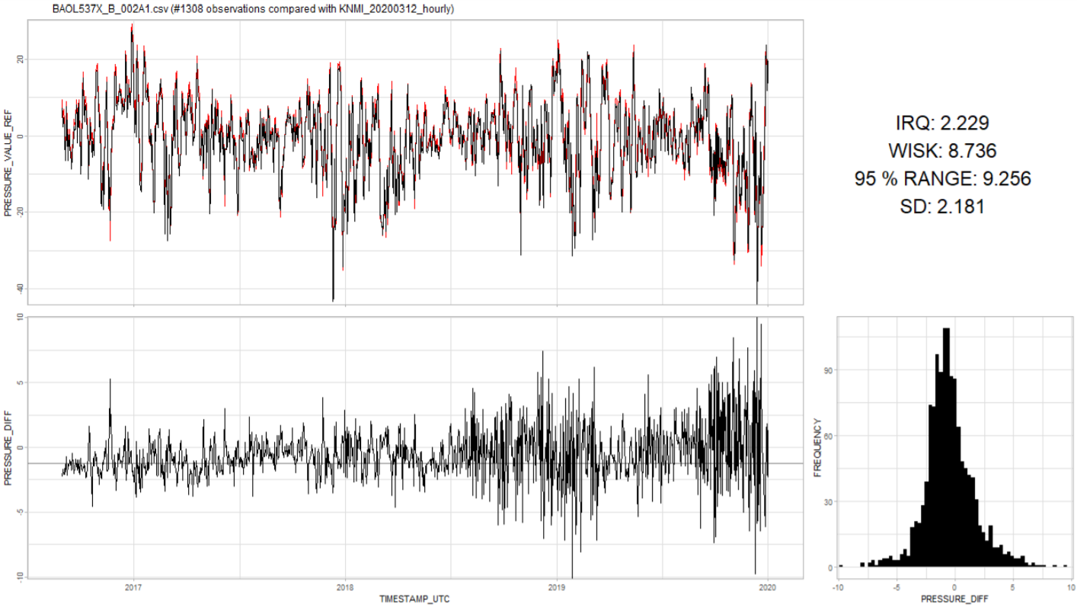
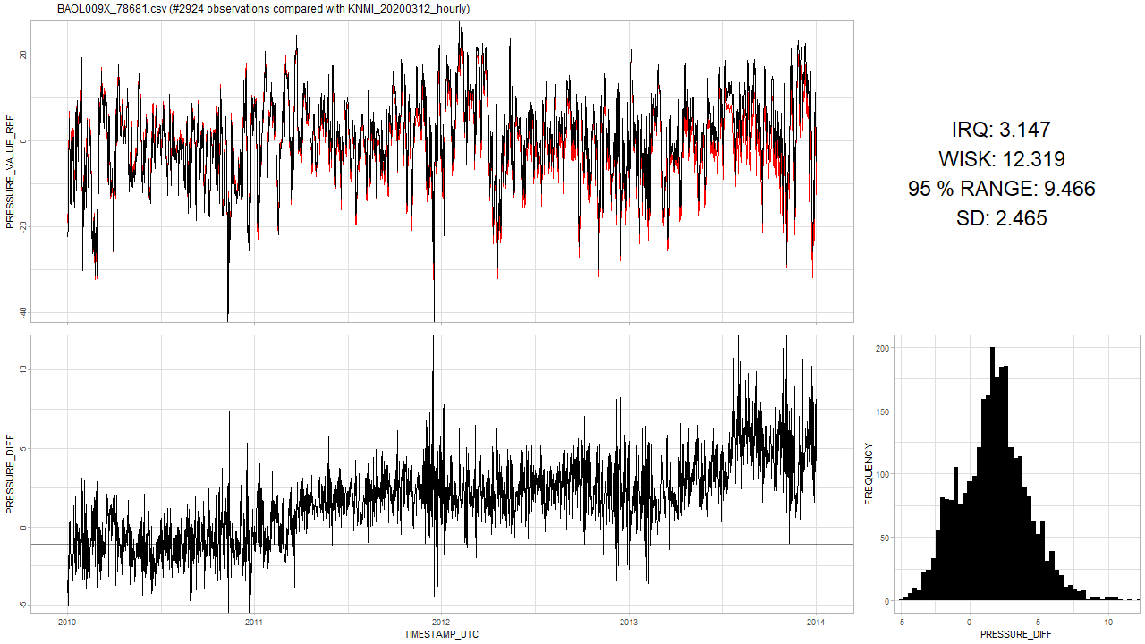
Next steps detect_drift()
Most of the analysis up till now was based on the variance of differences between one barometer vs. all/reference.
Hysteresis is indistinguishable from drift based on variance alone:
Notes:
Similar variance numbers

Slide 56
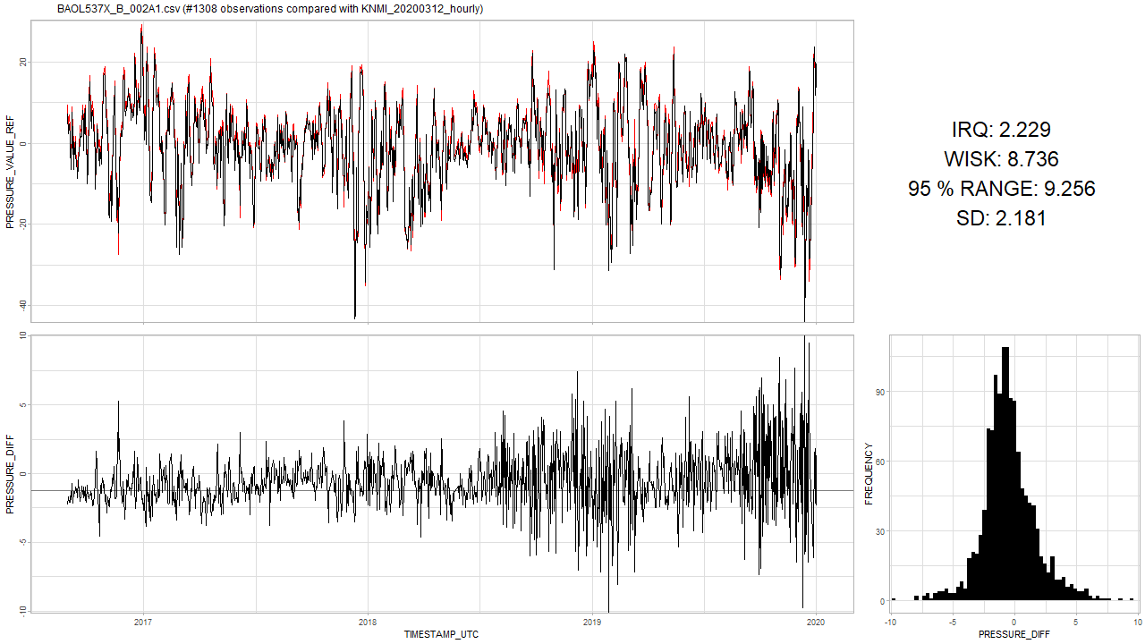

Next steps detect_drift()
Based on “Multi or Reference comparison” analysis.

Slide 57
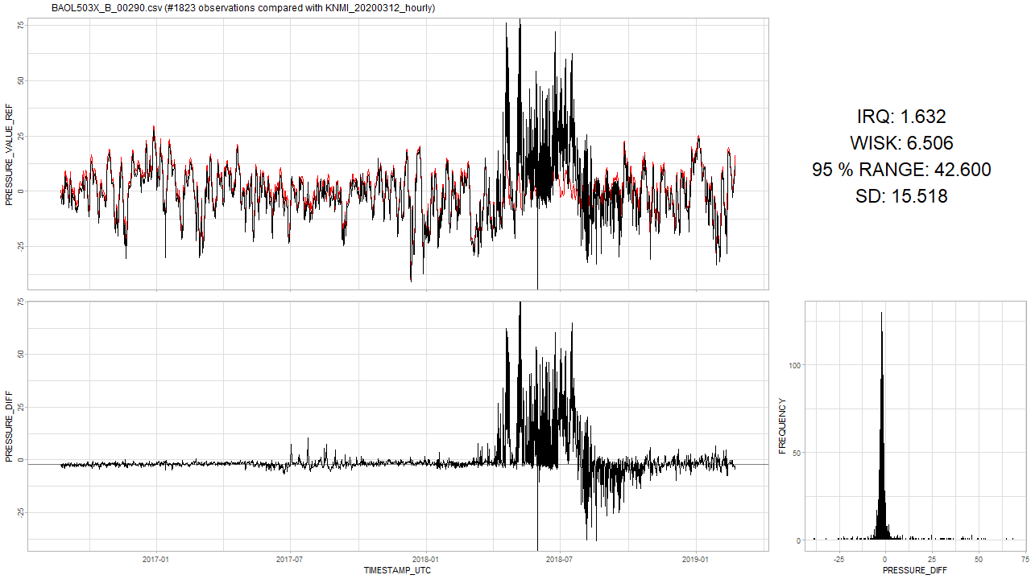
Next steps detect_drift()
Might cause trouble for an algorithm.
And then there is the occasional trouble:

Slide 58
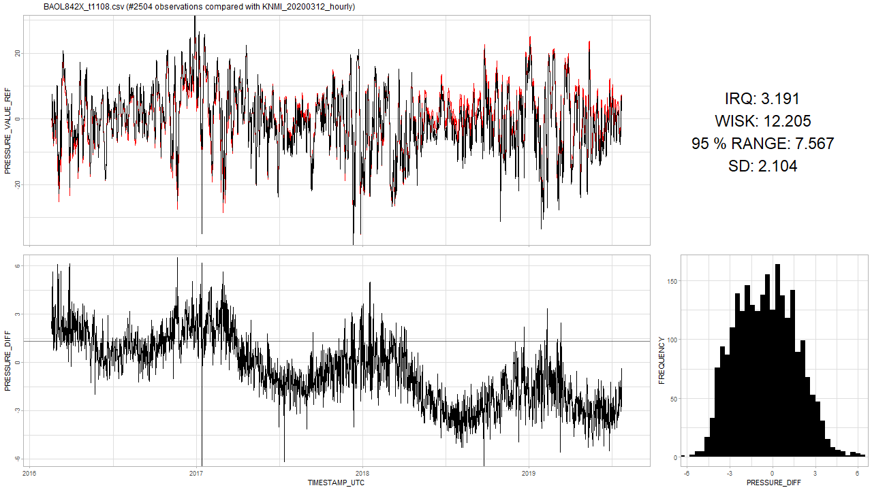
Next steps detect_drift()
Detecting up- or down-ward movement is tricky and in the starting phase, will mainly depend on how much new data on has.
When should the algorithm say that this one started drifting?
I think the algorithm should first detect seasonality, and then later a drift.
Notes:
Similar variance numbers

Slide 59
Next steps detect_drift()
A first tryout on the algorithm that can detect drifts?
Design
Implementation
Assessment
Analysis on the seasonality pattern:
Specific frequency (i.e. yearly) or multiple frequencies?
Notes:
Similar variance numbers

Slide 60
The End

Slide 61
Sprint 7
Analysis: drifts in air pressure

Slide 62
Agenda
Air pressure data analysis
Altitude
Temperature
Humidity
Barometer drift detection
Pairwise difference model
Multi difference model
Next steps
Questions

Slide 63
Air pressure modeling
Theory and data analysis

Slide 64

Air pressure
Model for pressure based on ideal gas law:
$$P=ρ\frac{R}{M}T$$
And Bernoulli’s equation:
$$P+\frac{1}{2}ρv^{2}+ρgh=constant$$
$h$ and $T$ depend on:
Altitude
$ρ$ depends on:
Temperature
Humidity
$v$ depends on:
Flow

Slide 65


Altitude Barometric formula
Around sea-level, an increase of 100 m in altitude corresponds to a decrease of 12 cmH2O in air pressure.
Notes:
https://en.wikipedia.org/wiki/Barometric_formula#Derivation

Slide 66

Altitude Barometric formula
Notes:
https://en.wikipedia.org/wiki/Barometric_formula

Slide 67

Altitude Barometric formula
Notes:
https://en.wikipedia.org/wiki/Barometric_formula

Slide 68

Barometer altitude
Notes:
Can be extracted with e.g. Google Elevation API for comparison.

Slide 69

Temperature Data analysis
Temperature distribution of all barometers.

Slide 70

Temperature Data analysis
Raw data: BAOL016X_W1666.csv and BAOL050X_56819.csv excluded.
Notes:
Blue line is the median regression.

Slide 71

Temperature Data analysis
Notes:
Blue line is the median regression. Yellow is OLS: might be influenced by outliers.

Slide 72

Temperature Theory
$$P=ρ\frac{R}{M}T$$
Both $ρ$ and $T$ are unknown (and interdependent)
We have only one equation
For discussion, see here
Theoretical effect of local temperature change on air pressure unknown. More research needed.

Slide 73

Temperature Data analysis
The bulge? Seasonal?
Notes:
Blue line is the median regression.

Slide 74

Humidity Data analysis
Bulge due to high humidity?

Slide 75

Humidity Theory
$$P=ρ\frac{R}{M}T$$
Theory assumes known $P$ and uses Dalton's law of partial pressures for density $ρ$ calculations.
$M$ (molar mass) is also impacted, again too many unknowns, so approximations are used. See here, note 14.
Theoretical effect of humidity on air pressure unknown. More research needed.

Slide 76
Summary
Altitude
Effect is significant: 12 cmH2O per 100m.
Temperature: effect unknown
Data analysis suggests 0,07 cmH2O drop per 1 °C. Over the observed range [-10, 50] °C this amounts to 4 cmH2O change.
Humidity: effect unknown
Seasonality analysis shows humidity has no impact on mean air pressure.
Humidity might be causing more lower pressure observations during non-summer time. (i.e. the bulge around 5 °C)

Slide 77
Barometer drift analysis
Theory and results

Slide 78

Ideal situation: 2 barometers side by side
$X_{t}=μ_{t}+ε_{X}$ and $Y_{t}=μ_{t}+ε_{Y}$
Subtract yields:
$$X_{t}−Y_{t}=ε_{X}−ε_{Y}=ε_{XY}∼N(0, σ_{X}^{2}+σ_{Y}^{2})$$
Notes:
Neem aan dat epsilons normal verdeeld zijn.

Slide 79

Pairwise comparison Two barometers close to each other.
At 11m and 13m altitude? So differences are white noise around 0 cmH2O.
Notes:
At 11m and 13m altitude.

Slide 80


Situation: 2 barometers at a distance
$$X_{t}=μ_{t}+ε_{X}$$
and
$$Y_{t}=μ_{t}+ε_{Y}+ε_{d(X,Y)}$$
Subtract yields:
$$X_{t}−Y_{t}=ε_{XY}+ε_{d(X,Y)}$$
$$∼N(0, {σ_{X}^{2}+σ_{Y}^{2}+σ}_{ d(X,Y)}^{2})$$

Slide 81

Pairwise comparison Two barometers close to each other.
At -27m and -23m altitude? So differences are white noise around 0 cmH2O.

Slide 82





Pairwise comparison SD (MAD) of pressure differences (cmH2O) vs distance (km): Q50 and Q10
$$\sqrt{σ_{X}^{2}+σ_{Y}^{2}}$$
$$\sqrt{σ_{X}^{2}+σ_{Y}^{2}+σ_{d(X,Y)}^{2}}$$

Slide 83


Situation: 2 barometers at a distance and different altitude
$$X_{t}=μ_{t}+h_{X}+ε_{X}$$
and
$$Y_{t}=μ_{t}+h_{Y}+ε_{Y}+ε_{d(X,Y)}$$
Subtract yields:
$$X_{t}−Y_{t}=h_{X}−h_{Y}+ε_{XY}+ε_{d\left(X,Y\right)}$$
$$∼N(h_{X}−h_{Y}, {σ_{X}^{2}+σ_{Y}^{2}+σ}_{ d(X,Y)}^{2})$$

Slide 84

Pairwise comparison Two barometers far from each other.
At -32m and 13m altitude? So differences are white noise around 6 cmH20.

Slide 85

Pairwise comparison Two barometers while one drifting: high SD
Very high SD due to drift.
Notes:
Als nodig, dan kan ik die plots nog verbeteren… want in analyse 02 is matching niet optimaal.

Slide 86





Pairwise comparison Problems

Slide 87
Pairwise comparison Conclusion
They do not tell us which one is drifting,
If they both drift the same way, we do not even see it.

Slide 88

Situation: multiple barometers at a distance and different altitude
$$X_{t}=μ_{t}+h_{X}+ε_{X}$$
and
$$Y_{i,t}=μ_{t}+h_{Y_{i}}+ε_{Y_{i}}+ε_{d(X,Y_{i})} Y_{i}∈ℬ ∖ X$$
Subtract yields:
$X_{t}−Y_{1,t}=h_{X}−h_{Y_{1}}+ε_{XY}+ε_{t, d\left(X,Y_{1}\right)}$ $∼N(h_{X}−h_{Y_{1}}, {σ_{X}^{2}+σ_{Y_{1}}^{2}+σ}_{ d(X,Y_{1})}^{2})$
$X_{t}−Y_{2,t}=h_{X}−h_{Y_{2}}+ε_{XY}+ε_{t, d\left(X,Y_{2}\right)}$ $∼N(h_{X}−h_{Y_{2}}, {σ_{X}^{2}+σ_{Y_{2}}^{2}+σ}_{ d(X,Y_{2})}^{2})$
$$⋮$$
$X_{t}−Y_{n,t}=h_{X}−h_{Y_{n}}+ε_{XY}+ε_{t, d\left(X,Y_{n}\right)}$ $∼N(h_{X}−h_{Y_{n}}, {σ_{X}^{2}+σ_{Y_{n}}^{2}+σ}_{ d(X,Y_{n})}^{2})$
Notes:
Als hier nu een paar Yi fout zijn, maar de meeste Yi juist zijn, dan zouden die paar foute geen al te grote

Slide 89

Multi comparison One barometer vs all the rest

Slide 90

Multi comparison One barometer vs all the rest

Slide 91

Multi comparison One barometer vs all the rest

Slide 92
Multi comparison One barometer vs all the rest

Slide 93

Multi comparison One barometer vs all the rest

Slide 94

Multi comparison One barometer vs all the rest
Temperature pattern in blue: positively correlated.

Slide 95

Multi comparison One barometer vs all the rest
You never see barometers first oscillating and then stabilizing.
Notes:
Feit dat ze altijd naar het einde toe oscilleren weerlegt een mogelijk argument dat de baro’s in andere tijdenlijk andere weeromstandigheden staan.

Slide 96

Multi comparison One barometer vs all the rest

Slide 97

Multi comparison One barometer vs all the rest
Temperature pattern in blue: negatively correlated.

Slide 98

Multi comparison One barometer vs all the rest

Slide 99

Multi comparison One barometer vs all the rest

Slide 100

Multi comparison One barometer vs all the rest
Sometimes negative, sometimes positive correlation?

Slide 101

Multi comparison One barometer vs all the rest
Temperature peaks not in sync at the end.

Slide 102

Multi comparison One barometer vs all the rest
This one is still good.

Slide 103

Multi comparison One barometer vs all the rest

Slide 104

Multi comparison One barometer vs all the rest

Slide 105

Multi comparison One barometer vs all the rest
Old but also still good.

Slide 106

Multi comparison One barometer vs all the rest

Slide 107

Multi comparison One barometer vs all the rest

Slide 108

Multi comparison One barometer vs all the rest

Slide 109

Multi comparison One barometer vs all the rest

Slide 110

Multi comparison One barometer vs all the rest

Slide 111

Multi comparison One barometer vs all the rest

Slide 112

Multi comparison One barometer vs all the rest
Very old but still “OK”? The oscillations are not all that big. Why?

Slide 113

Multi comparison One barometer vs all the rest

Slide 114

Multi comparison One barometer vs all the rest

Slide 115

Multi comparison One barometer vs all the rest
Where will it end?

Slide 116

Multi comparison One barometer vs all the rest
What happened?

Slide 117

Multi comparison One barometer vs all the rest
Calibration test could verify this one is too low currently?

Slide 118

Multi comparison One barometer vs all the rest
This one “was” new? Now unstable?

Slide 119

Multi comparison One barometer vs all the rest
Unstable?

Slide 120

Multi comparison One barometer vs all the rest
Unstable?

Slide 121

Multi comparison One barometer vs all the rest
Unstable?

Slide 122

Multi comparison One barometer vs all the rest
Unstable?

Slide 123

Multi comparison One barometer vs all the rest
Unstable?

Slide 124

Multi comparison: remarks
Universal way of matching barometers on timestamps.
Truncation: 12h
E.g. observation at 2019-02-02 13:05:00 UTC is truncated to 2019-02-02 12:00:00 UTC
Averaging over truncated values.
Missing values for barometers are a potential problem.
E.g. for 2020, if there is no barometers available for comparison, or if there is only a limited number of barometers available?
Seems many barometers become sensitive to temperature changes after x years?
No clear temperature dependence pattern.
Many barometers seem broken? Median assumes about 50 % non-broken.
After BAOL1XX less drifting cases but more unstable cases?
Some are just unstable? (i.e. not drifting)
Mostly BAOL5XX

Slide 125

Next steps
Continue “multi-comparison” analysis?
Try removing altitude-effect for better comparison? (e.g. remove $h_{X}$ and $h_{Y}$)
Compare altitudes based on barometric formula with real elevation based on the coordinates
…?
First algorithm: detect trend $α≠0$ for some structural break at $t_{b}$ for model $y=c+αtI\left(t>t_{b}\right)+ε$
detect_drifts(x, other)
Need enough “other” data to compute “x”. Problem: what is enough?
Detect any significant change in trend $α$ after $t_{b}$.
detect_drifts(x)
Can be based on apriori data about $α$. If trend $α$ is larger than the worst case in apriori data, then flag from $t_{b}$.
detect_drifts(x, altitude)
…?

Slide 126

Next steps: potential problems
How certain are we that barometers from analysis 04 are broken?
Need a validated set of drifting and non-drifting barometers to make comparisons of algorithms.
Unstable barometers: detecting change after $t_{b}$ with $α≠0$ is difficult.

Slide 127

Questions?
Frederic: question from GitHub solved?
Frederic: “Typically one Barologger can cover a radius of 30 km (20 mile) and/or every 300 m (1000 ft) elevation change.”
Radius 30 km: error SD increase with 0,3 cmH2O (analysis)
Elevation change of 300 m: 36 cmH2O change in mean (barometric formula)
Piet: hydrostatic error: 2 cmH2O.
For baro’s from analysis of median: 1,3 cmH2O
After about 100km the error is also 2 cmH20 due to distance.
Piet: -20 tot 50 °C: effect?
Effect based on analysis: 70 * 0,068 = 4,8 cmH2O

Slide 128
The End

